Slide 1

C Developer
Discover the C Syntax

Slide 2

Course Objectives
Declare and handle variables
Manage inputs and outputs

Slide 3

Course Plan
1. Code Structure
2. Variables
3. Preprocessor Directives
4. Operators

Slide 4

1. Code Structure

Slide 5


1. Code Structure
Main
It is the entry point of the C program
It must be unique
Each instruction ends with “;”

Slide 6
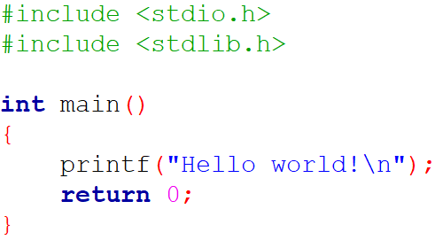

1. Code Structure
Main
Start the program without argument

Slide 7
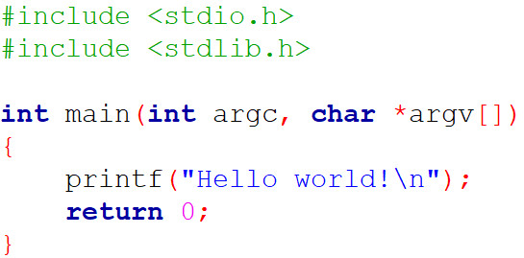


1. Code Structure
Main
Start the program with argument(s)

Slide 8
1. Code Structure
Include Libraries
A program contains many instructions
– #include preprocessor directive
– <file.h> compiler include
<stdio.h>
– Stands for Standard Input Output
– Has the information related to input/output functions
<stdlib.h>
– Stands for Standard Library
– Has the information of memory allocation/freeing functions

Slide 9
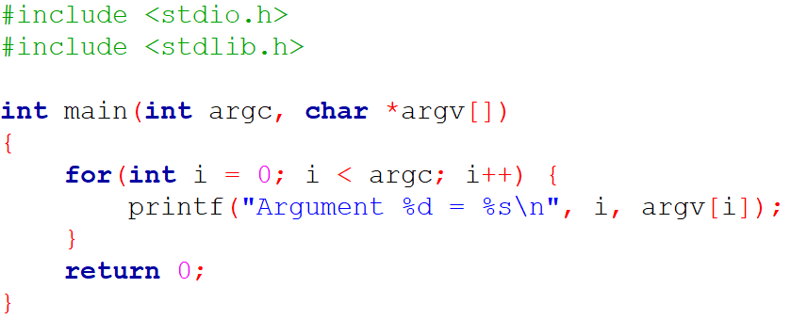
1. Code Structure
Include Libraries
With the default header files, we can print arguments

Slide 10
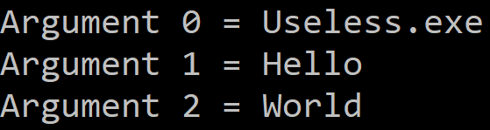
1. Code Structure
Include Libraries
With the default header files, we can print arguments

Slide 11
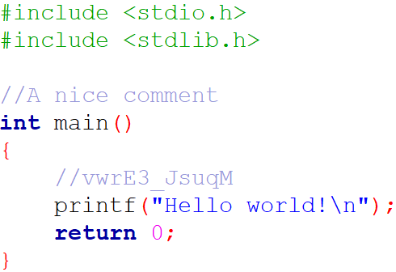
1. Code Structure
Comments
To insert a comment, use “//”

Slide 12
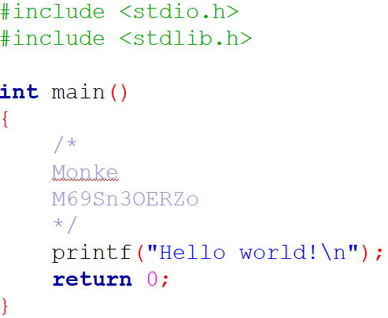
1. Code Structure
Comments
To insert a block of comments, use “/* … */”

Slide 13

1. Code Structure
Exercise
Create a new Code::Blocks C project named “HelloArgument”
Print “Hello SUPINFO!”
Print only 5 arguments

Slide 14

1. Code Structure
Questions

Slide 15

2. Variables

Slide 16
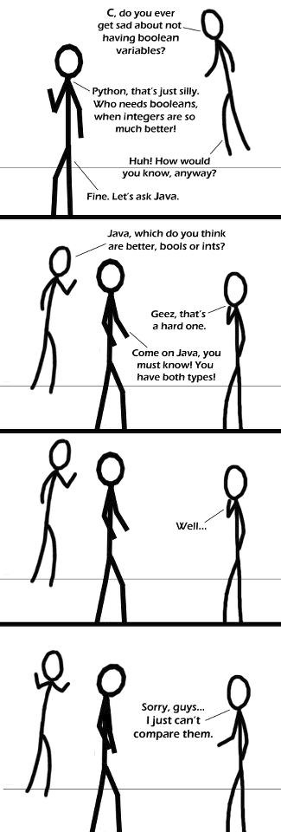
2. Variables
Introduction
To use information, you must know how it is encoded in memory:
– Integer
– Decimal
– Character
There is no boolean type!

Slide 17
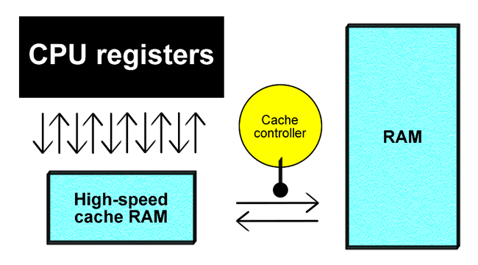
2. Variables
Introduction
All variables are numbers in memory
Memories are binary (Register, Cache, RAM)
Information is stored by a sequence of 0 and 1

Slide 18
2. Variables
Introduction
A representation of the memory
Address | Value
0000 | 1337
0001
0002 | a
0003 | 8
0004
0005
0006
0007 | 42

Slide 19
2. Variables
Integer
Type | Size (min) | Min | Max
short | 2 bytes/16 bits | -32 768 | +32 767
unsigned short | 2 bytes/16 bits | 0 | +65 535
int | 4 bytes/32 bits* | -2 147 483 648 | +2 147 483 647
unsigned int | 4 bytes/32 bits* | 0 | +4 294 967 295
long | 4 bytes/32 bits | -2 147 483 648 | +2 147 483 647
unsigned long | 4 bytes/32 bits | 0 | +4 294 967 295
long long (C99) | 8 bytes/64 bits | -9 223 372 036 854 775 808 | +9 223 372 036 854 775 807
unsigned long long (C99) | 8 bytes/64 bits | 0 | +18 446 744 073 709 551 615
Notes:
*Sensitive to the system: could also be as 2 bytes/16 bits, as {Unsigned} Short (with the corresponding range)

Slide 20
2. Variables
Integer
Example of unsigned short:
Decimal | Binary (in memory) | Hexadecimal
1 | 00000000 00000001 | 0001
2 | 00000000 00000010 | 0002
3 | 00000000 00000011 | 0003
… | … | …
65 534 | 11111111 11111110 | FFFE
65 535 | 11111111 11111111 | FFFF

Slide 21
2. Variables
Integer
Example of signed short:
Decimal | Binary (in memory) | Hexadecimal
32 767 | 01111111 11111111 | 7FFF
… | … | …
1024 | 00000100 00000000 | 0400
… | … | …
0 | 00000000 00000000 | 0000
-1 | 11111111 11111111 | FFFF
… | … | …
-1024 | 11111100 00000000 | FC00
… | … | …
-32 768 | 10000000 00000000 | 8000

Slide 22

2. Variables
Integer
A good developer does not allocate more memory than necessary
The program will be more efficient
Choose the right type of variable

Slide 23
2. Variables
Decimal
Real numbers are represented either in decimal form or using a power of 10:
280.61 = 2.8061e2 = 28061E-2
Type | Size (min) | Precision (decimal) | Min | Max
float | 4 bytes/32 bits | 6 | 1.2E-38 | 3.4E+38
double | 8 bytes/64 bits | 15 | 2.3E-308 | 1.7E+308
long double | 12 bytes/96 bits* | 18 | 3.4E-4932 | 1.1E+4932
Notes:
*Sensitive to the system: could also be as 10 bytes/80 bits and 19 decimal precision

Slide 24
2. Variables
Character
A character is a number
– The letter “A” (uppercase) is stored as 65 in the memory (ASCII)
A char is a representation of a character of an integer from -128 to 127
An unsigned char is a representation of a character of an integer from 0 to 255

Slide 25
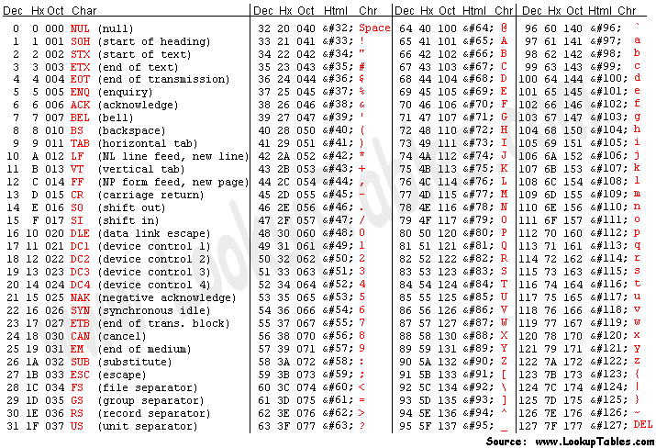
2. Variables
Character
ASCII table

Slide 26
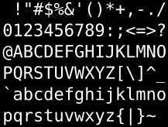
2. Variables
Character
The characters from 32 to 126 can be displayed as follows:
To manipulate a character, you can use “ ' … ' ”
– 36 and '$' are identical (just like '\x24' for hexadecimal lovers)
String handling is a bit tricky

Slide 27
2. Variables
Character
Some non-displayable characters can also be designated without their ASCII code, using a “\” between quotes
Escape Sequence | ASCII Code (Decimal) | ASCII Code (Hexadecimal) | Meaning
\n | 10 | A | New Line
\t | 9 | 9 | Horizontal Tab
\b | 8 | 8 | Backspace
\r | 13 | D | Carriage Return
\a | 7 | 7 | (Alert) Bell
\' | 39 | 27 | Single Quote
\" | 34 | 22 | Double Quote
\? | 63 | 3F | Question Mark
\\ | 92 | 5C | Backslash
\f | 12 | C | Form Feed
\v | 11 | B | Vertical Tab
\0 | 0 | 0 | Null Character

Slide 28

2. Variables
Summary
char
unsigned char
short
unsigned short
int
unsigned int
long
unsigned long
long long
unsigned long long
float
double
long double
Hierarchy

Slide 29
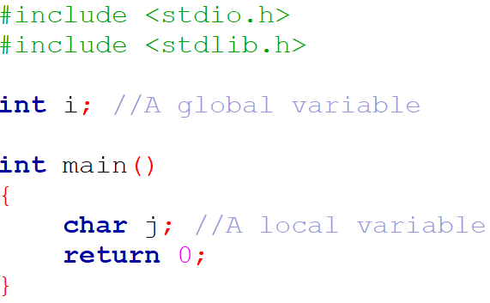
2. Variables
Declaration and assignment
Variable can be declared as:
– Global (available anywhere)
– Local (available in the current scope)

Slide 30
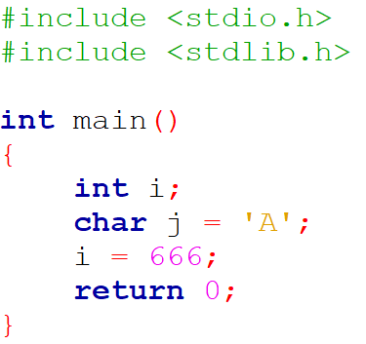
2. Variables
Declaration and assignment
The assignment:
– can be made during the declaration or later in the program
– is done with the “=” operator

Slide 31
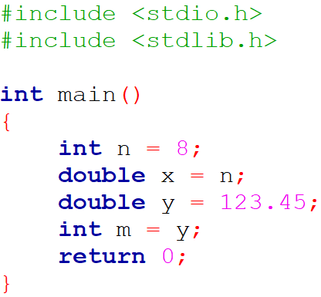
2. Variables
Declaration and assignment
You can assign the value of a variable of a certain type to a variable of another type
This implicit conversion is carried out without or with loss of information
n = 8
x = 8
y = 123.45
m = 123

Slide 32
2. Variables
Convention
The name of a variable is referred as an identifier
It must follow some rules:
– It can contain letters (uppercase or lowercase), digits and underscores “_”
– The first character must be a letter or an underscore (but avoid it for the last)
– Most C compilers have a limit of 255 characters for an identifier, but ANSI standard recognizes a length of 31 characters for a variable name
Underscore is used to separate elements of an identifier
Uppercase letters are recommended for ease of reading

Slide 33
2. Variables
Convention
Do not use reserved keywords!
C variable is case-sensitive
Use a descriptive variable name and prefer to start with a lowercase letter
auto | break | case | char | const | continue
default | do | double | else | enum | extern
float | for | goto | if | int | long
register | return | short | signed | sizeof | static
struct | switch | typedef | union | unsigned | void
volatile | while

Slide 34
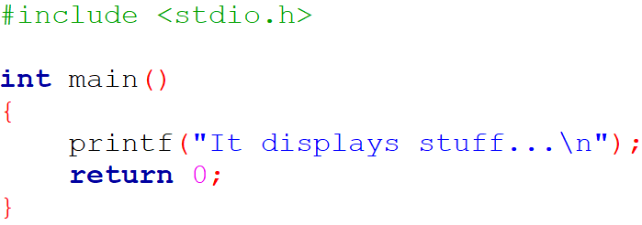

2. Variables
Display a variable
Use the stdio header and the printf function

Slide 35
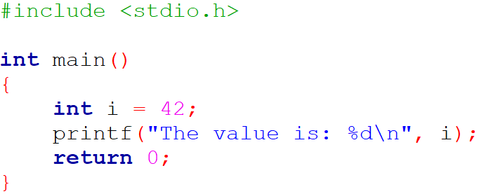

2. Variables
Display a variable
To display variables, use a format specifier of variable type
– int with the format specifier %d

Slide 36
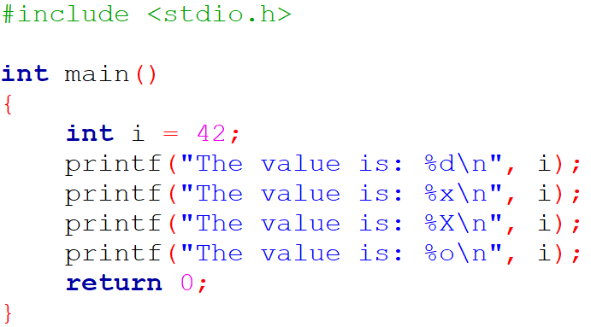
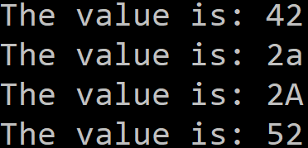
2. Variables
Display a variable
– %x or %X to convert in hexadecimal, %o in octal

Slide 37
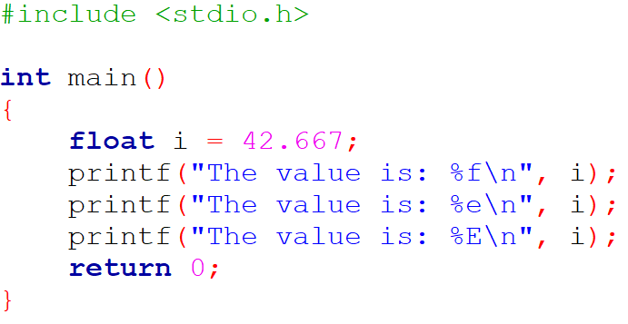
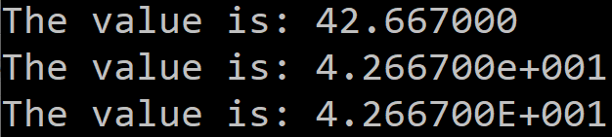
2. Variables
Display a variable
– float with the format specifier %f (%e or %E to use the scientific notation)

Slide 38
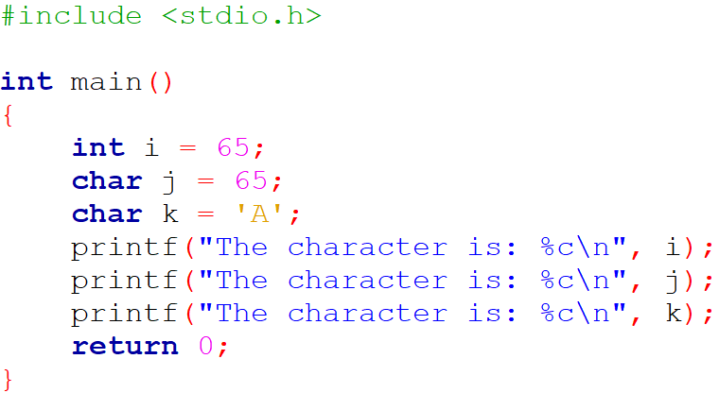
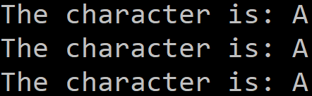
2. Variables
Display a variable
– char with the format specifier %c

Slide 39
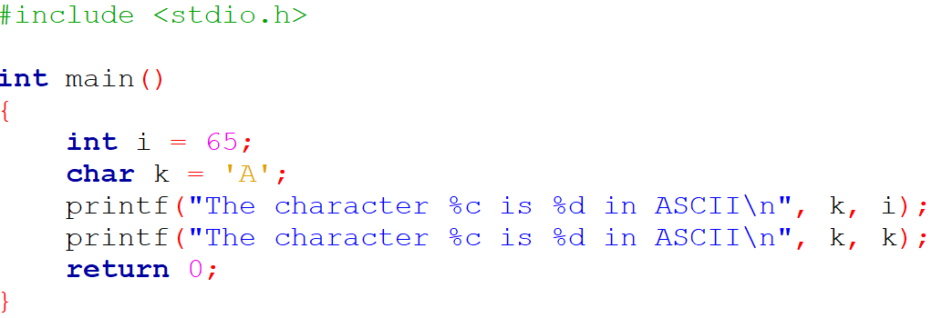

2. Variables
Display a variable
You can display multiple variables with the same printf

Slide 40
2. Variables
Format specifier examples
Data Type | Format Specifier
char | %c
unsigned char | %c
short | %hd
unsigned short | %hu
int | %d
unsigned int | %u
long | %ld
unsigned long | %lu
long long | %lld
unsigned long long | %llu
float | %f
double | %lf
long double | %Lf
string | %s

Slide 41
2. Variables
Read a variable
Use the stdio header and the scanf function to request an input
Use a format specifier of variable type
Specify the address of the variable in the computer's memory
To display text related to the request, you need to use printf

Slide 42
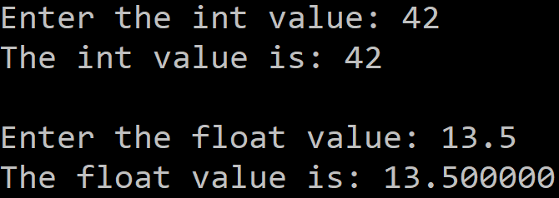
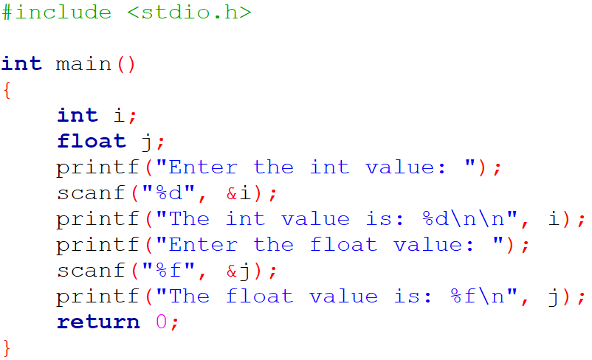
2. Variables
Read a variable

Slide 43
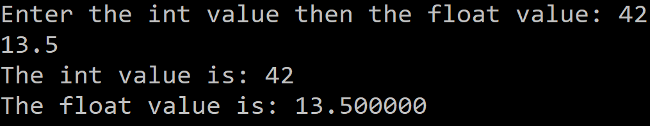
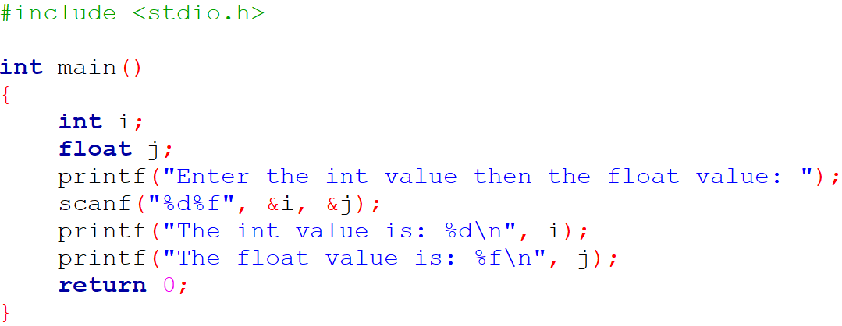
2. Variables
Read a variable
You can request multiple variables with the same scanf

Slide 44
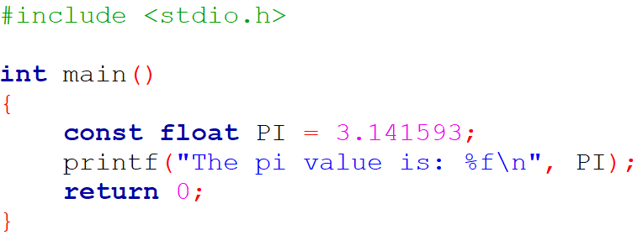
2. Variables
Constants
Use the const keyword
Do the assignment immediately

Slide 45
2. Variables
Exercise
You have the following URL, but 3 parts are missing:
https://www.youtube.com/watch?v=_WAOx_OmR_
Display the URL using the following variables at the missing places:
The character associated with the ASCII decimal value 51
The character associated with the ASCII hexadecimal value 4B
The ASCII decimal value associated with the character Z

Slide 46
2. Variables
Questions

Slide 47

3. Preprocessor Directives

Slide 48
3. Preprocessor Directives
#include
Both user and system header files are included
#include <file>
– It is used for system header files
– It searches for a file named file in directories pre-designated by the compiler/IDE (standard system)
– It is normally used to include standard library header files
#include "file"
– It is used for header files of your own program
– It searches for a file named file in the same directory as the file containing the directive (or using the relative path) then in pre-designated directories
– It is normally used to include programmer-defined header files

Slide 49

3. Preprocessor Directives
#define
Define a constant or create a macro
– Define
– Constant
– Macro without argument
– Macro with argument(s)
Notes:
The #undef directive undefines a constant or preprocessor macro defined previously.

Slide 50

3. Preprocessor Directives
Predefined macros
__LINE__: current line number
__FILE__: current file full path
__DATE__: current (compilation) date
__TIME__: current (compilation) time
__TIMESTAMP__ ≈ __DATE__ + __TIME__

Slide 51
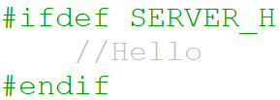
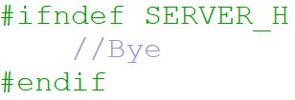
3. Preprocessor Directives
Conditions
Check if SERVER_H is defined
Check if SERVER_H is not defined
Notes:
Did you notice the transparency of the comments?

Slide 52
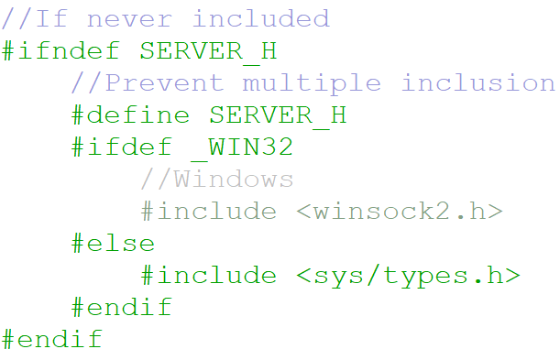
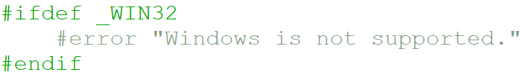
3. Preprocessor Directives
Conditions
The #error macro allows you to make compilation fail and issue a statement that will appear in the list of compilation errors

Slide 53
3. Preprocessor Directives
Questions

Slide 54

4. Operators

Slide 55
4. Operators
Categories
Arithmetic
Assignment and incrementation
Relational
Logical
Conditional

Slide 56
4. Operators
Arithmetic
Arithmetic operators: +, -, *, /, %
They are usually defined only for operands of the same type
When “/” is used with two integers, it returns the quotient of the Euclidean division of the first by the second
The “%” operator is only defined with integers and returns the remainder of the Euclidean division of the first by the second

Slide 57
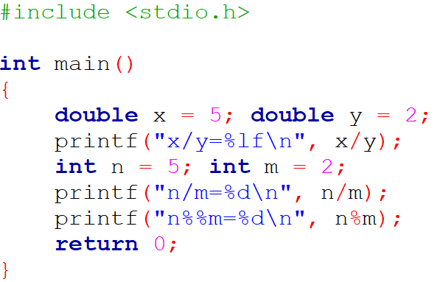
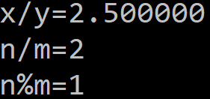
4. Operators
Arithmetic

Slide 58
4. Operators
Arithmetic
Reminders about implicit conversions:
– It may happen that we must perform a calculation between a real and an integer; the latter will then be implicitly converted into a real, and the result of the operation will also be real
– More generally, if needed, a variable of a given type can be converted into a “higher” type (float into double for example, and not the other way around)

Slide 59
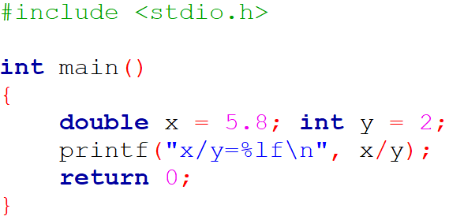

4. Operators
Arithmetic

Slide 60
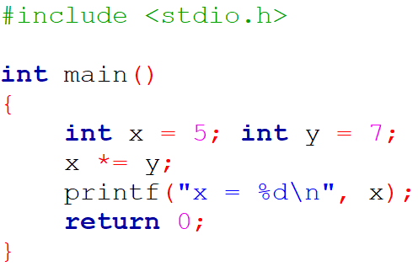

4. Operators
Assignment and incrementation
Assignment shortcuts | Meaning
x = x + y | x += y
x = x - y | x -= y
x = x * y | x *= y
x = x / y | x /= y
x = x % y | x %= y

Slide 61
4. Operators
Assignment and incrementation
To increment or decrement the value of a variable by 1 you can use the operators “++” or “--”
n++ and ++n will thus increment n by 1 but the value of these expressions is however different: n++ is the value of n before the increment and ++n is the value of n after the increment
Likewise with “--”

Slide 62
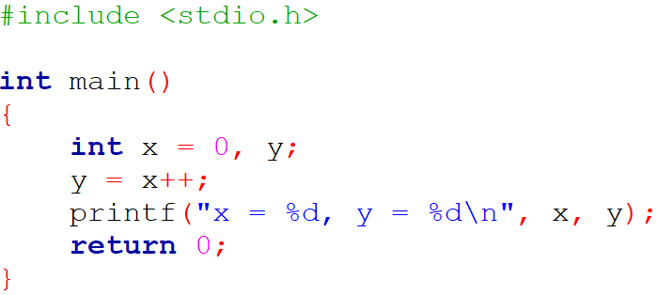



4. Operators
Assignment and incrementation

Slide 63
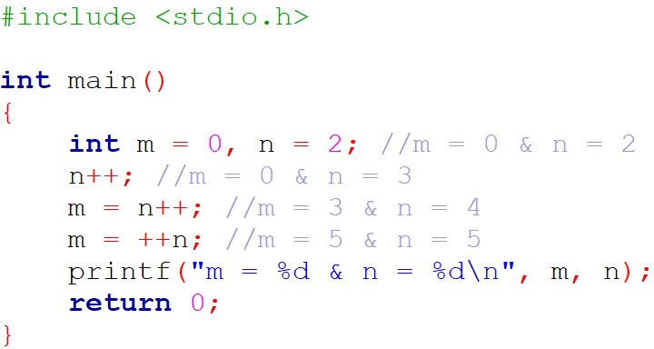

4. Operators
Assignment and incrementation

Slide 64
4. Operators
Relational
Relational operators: ==, !=, <=, >=, <, >
They deal with numerical values
They are subject to the implicit conversion rules
The result is an integer, worth 0 if the comparison is false, and 1 if it is true

Slide 65
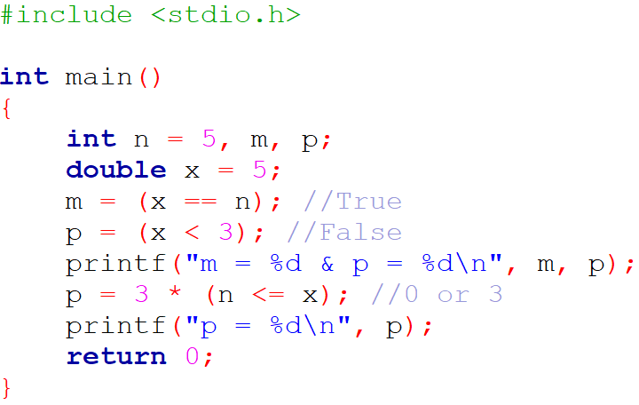

4. Operators
Relational

Slide 66
4. Operators
Logical
Logical operators: &&, ||, !
They correspond to AND, OR and NOT
They take as operand numerical values with the convention that 0 corresponds to FALSE and that any non-zero value corresponds to TRUE
The result is an integer worth 0 (FALSE) or 1 (TRUE)

Slide 67
4. Operators
Logical – Truth tables
z = x && y
x | y | z
0 | 0 | 0
0 | 1 | 0
1 | 0 | 0
1 | 1 | 1
z = x || y
z = !x
x | y | z
0 | 0 | 0
0 | 1 | 1
1 | 0 | 1
1 | 1 | 1
x | z
0 | 1
1 | 0

Slide 68
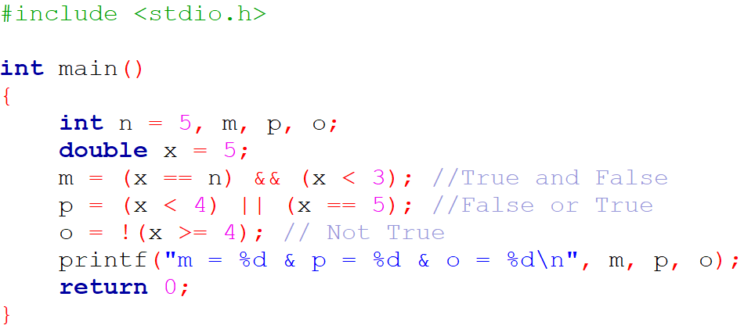
4. Operators
Logical

Slide 69
4. Operators
Conditional
Conditional operator: ?
You can use the logical and relational operators
Syntax:

Slide 70
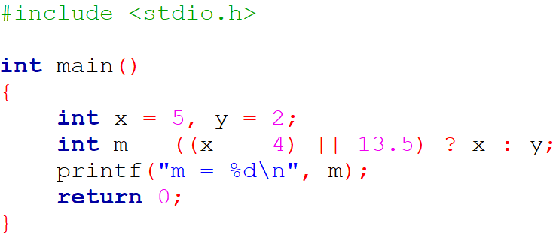

4. Operators
Conditional

Slide 71
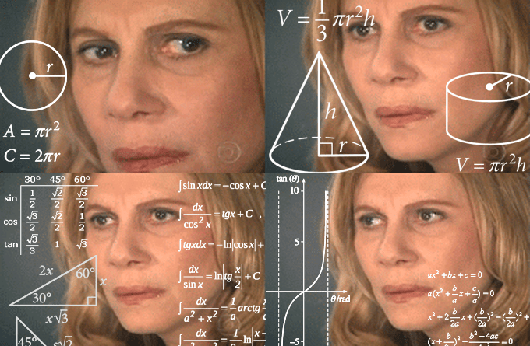
4. Operators
Math functions
#include <math.h>
acos | asin | atan | atan2
cos | cosh | sin | sinh
tanh | exp | frexp | ldexp
log | log10 | modf | pow
sqrt | ceil | fabs | floor
fmod

Slide 72
4. Operators
Exercise
Ask the user to enter a unit price before tax, a VAT rate and a quantity of items
Calculate and display the total price including VAT of the purchase

Slide 73
4. Operators
Questions

Slide 74

C Developer
Discover the C Syntax
Thank you for your attention

